Slide 1
IOT based Home Automation System
By. Arwa Aamir

Slide 2
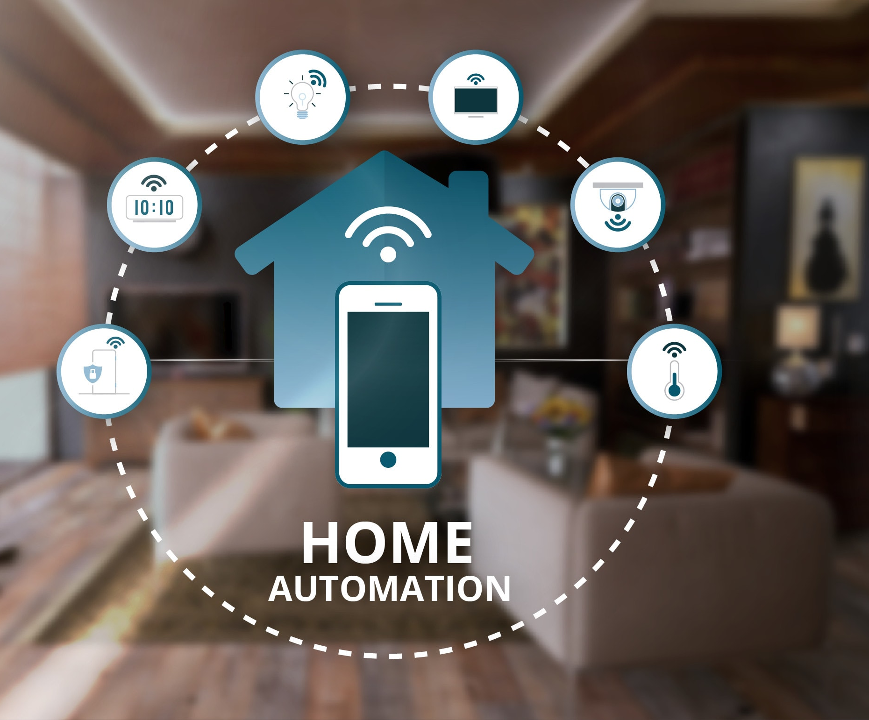
What is Home Automation?
Home Automation is a wireless home appliance control system accessed by a remote device such as mobile phone(Android or IOs) to allow a homeowner to control, monitor and coordinate home appliances, without changing the home infrastructure.

Slide 3
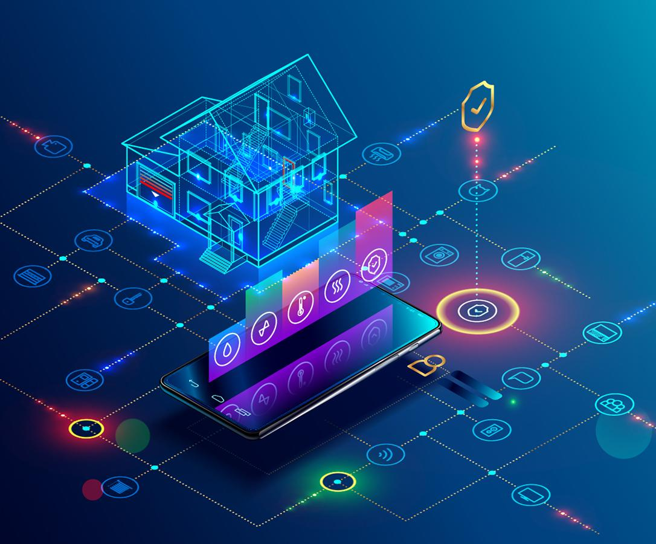
Why is Home Automation needed?
1. Saves time
2. Save money (Long run)
3. Self Maintenance
4. Security
5. Makes life easy

Slide 4
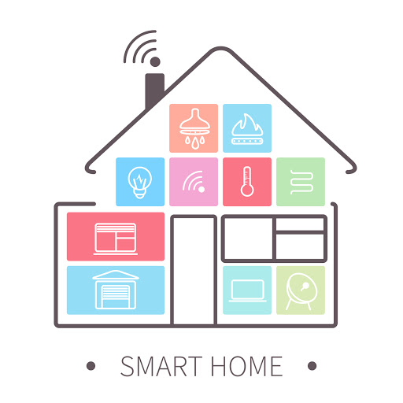
System Design
HA is a system which is controlled by a remote system such as a cell phone like , Android or IOs Phone.
It is built around a microcontroller ,with adjoining relays for interfacing with AC devices.
There will be sensors for the system to operate automatically according to weather conditions.
In case of emergency such as fire, the user or an organization such as Fire Department should be notified.
Also, HA should have a database of information about the users and appliances.

Slide 5
System Dataflow
Android Application
Database
Microcontroller
Relays
Appliances

Slide 6
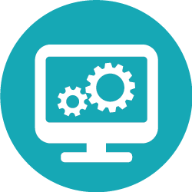
Software Description

Slide 7
Development Platforms
Andriod: Android has an active community of developers and enthusiasts who use the Android Open Source Project (AOSP) source code to develop and distribute their own modified versions of the operating system.
The Arduino Integrated Development Environment (IDE) is a cross-platform application that is written in functions from C and C++. It is used to write and upload programs to Arduino compatible boards, but also, with the help of third-party cores, other vendor development boards.

Slide 8
Andoid Application via MIT App Inventer
MIT App Inventor brings the power and simplicity of app creation to the Internet of Things (IoT) and connected devices.
The Firebase component that is provided by App Inventor is super useful, especially when you need to update any number of apps with fresh data. In addition to using Firebase as a datastore, you can also leverage its website authentication in your apps to take care of your user management needs.

Slide 9
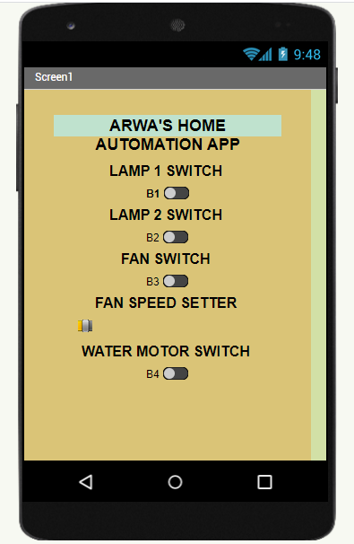
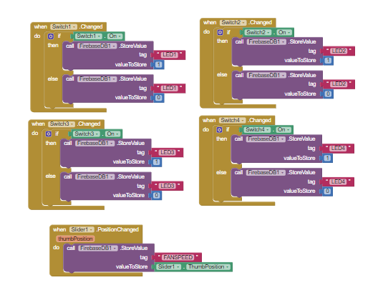

Slide 10
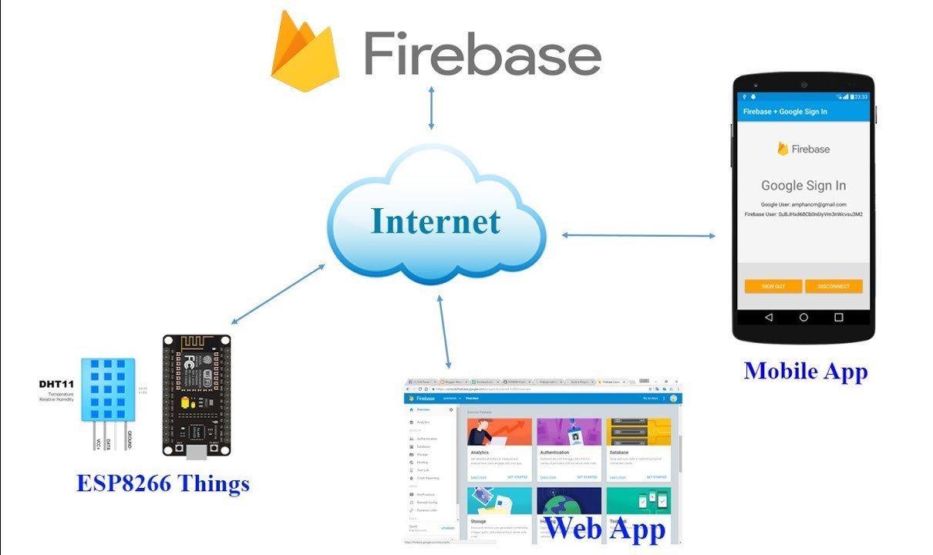
Database via Google Firebase
Google Firebase cloud is a platform that provides several services such as Authentication, real time database, and so on. To build this IoT project we will use a real time database features.

Slide 11
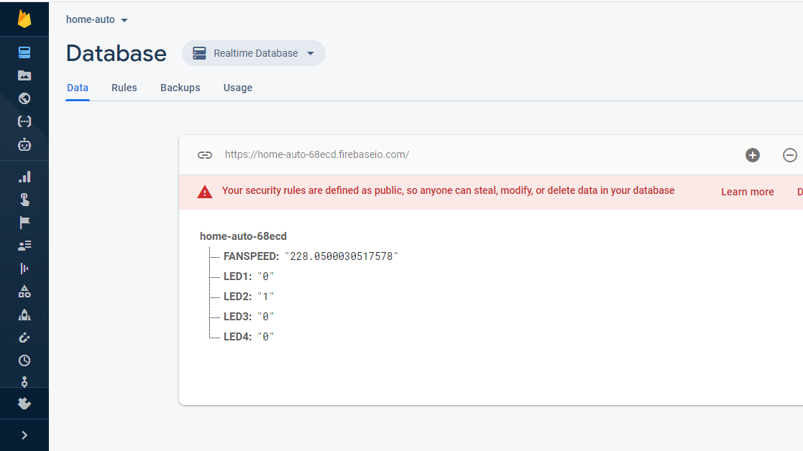

Slide 12

Hardware Description

Slide 13
Hardware Description
Home automation contains a controller, various sensors, relays, motors and further A.C. Appliances which are needed to be controlled.
It has ESP32 controller which provides the necessary signals for then output devices connected.
A water level sensor is used to control the automatic water motor.
Relays are connected in the circuit to switch the AC appliances and isolate them from the microcontroller.
AC-DC adapters are used for powering up the microcontrollers and DC Motors.
Voltage Regulators and Buck Converters are also used to bring down the level of DC voltage and restrain it to a constant level and avoid surges.

Slide 14
Block Diagram
Mobile App
Database
ESP-32
Bulb 2
Bulb 1
Fan
Automatic Water Motor
Water Sensor

Slide 15
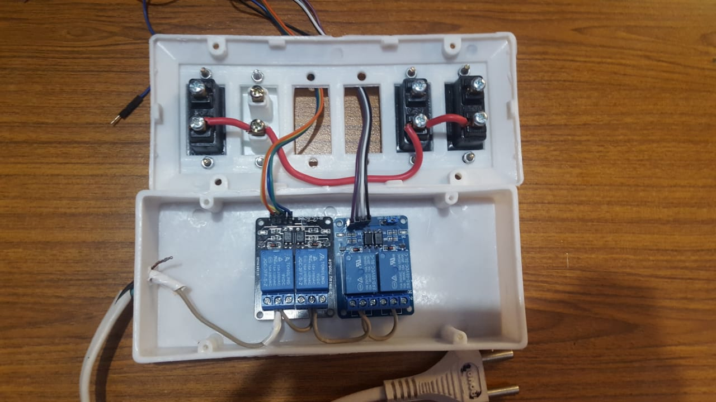

Slide 16
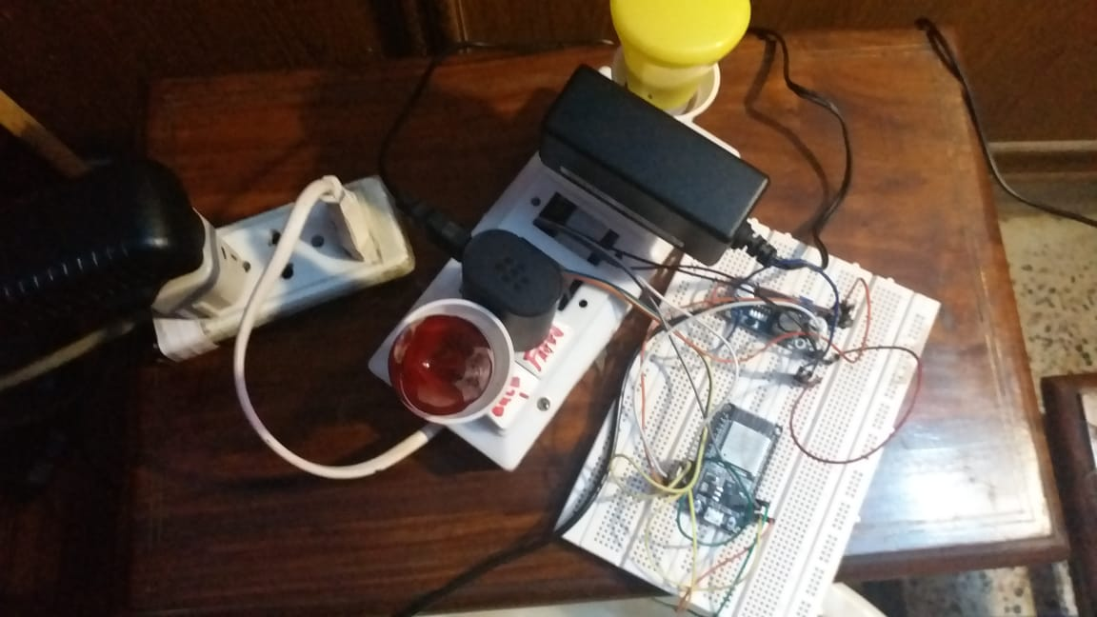

Slide 17


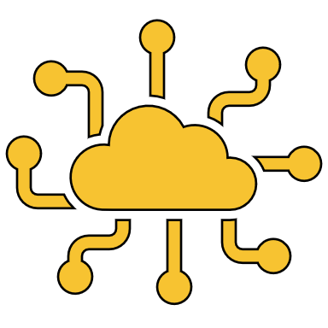
Thank You!

